Slide 1
Text Based Game Python Programming
CSUMB CST205
PRESENTED BY: DANIEL HOWE, JIWANOT SIDHAU, ROGELIO MORENO, NIKOLA PETKOV

Slide 2
Overview
OBJECTIVE
APPROACH
RESULTS

Slide 3

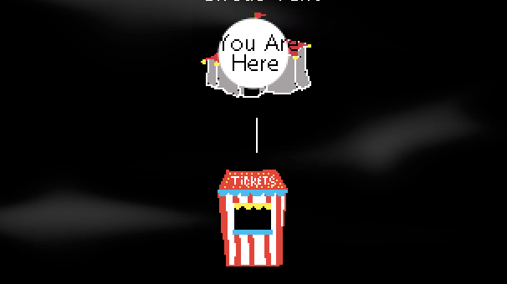
Objective

Slide 4
Objective
USER INTERACTION/ENGAGEMENT
KEYBOARD
SOUND
IMAGES
PROCESS STRINGS
NAVIGATION
HISTORY
COMMANDS

Slide 5
Approach

Slide 6
Approach
Request user to enter their name
Allow user to choose direction of play
Store history
Preserve game logic unique to area

Slide 7
Results

Slide 8
results
Found limitations with filenames:
Windows filename :
“C:\\Users\Elmo\Dorothy”
Mac OS/Linux Filename:
/home/elmo/dorothy
Repaint/draw images

Slide 9
Demo

Slide 10
Wrap up
Learning Resources:
Image Credits:

